Slide 1


General Section of the SACC Standard of Points
Desirable and undesirable aspects relevant to All Breeds as pertaining to breeding and showing.
By: Santie Meyer

Slide 2


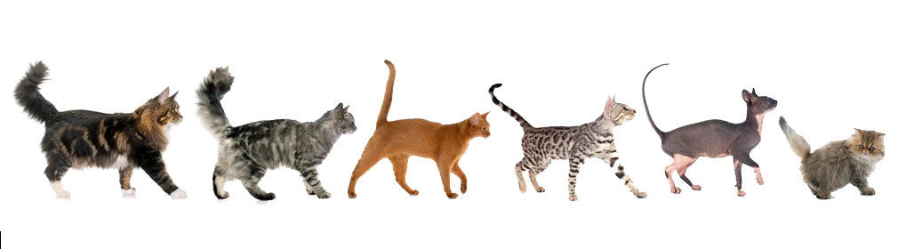
DESIRABLE FEATURES IN
ALL BREEDS
Firm chin and level bite
Eyes clear and bright with evenness of colour
Toes – 5 on each front paw, and four on each hind paw, complete with claws

Slide 3
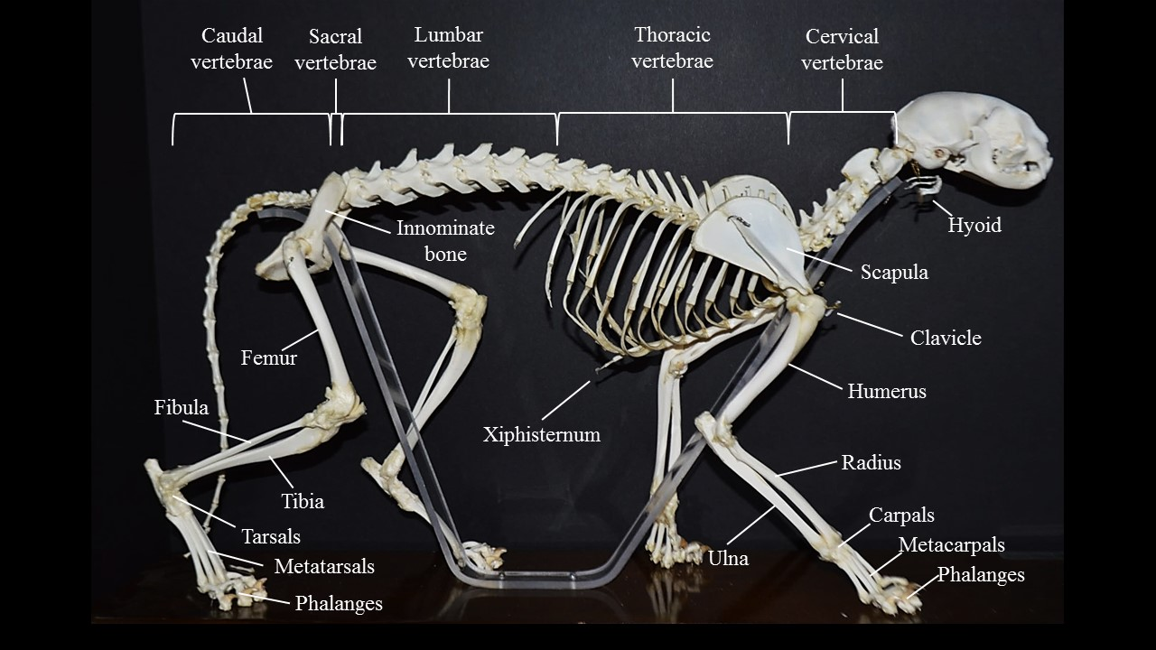
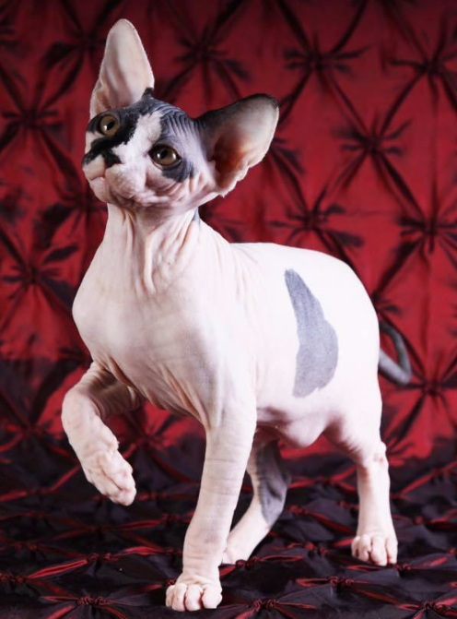
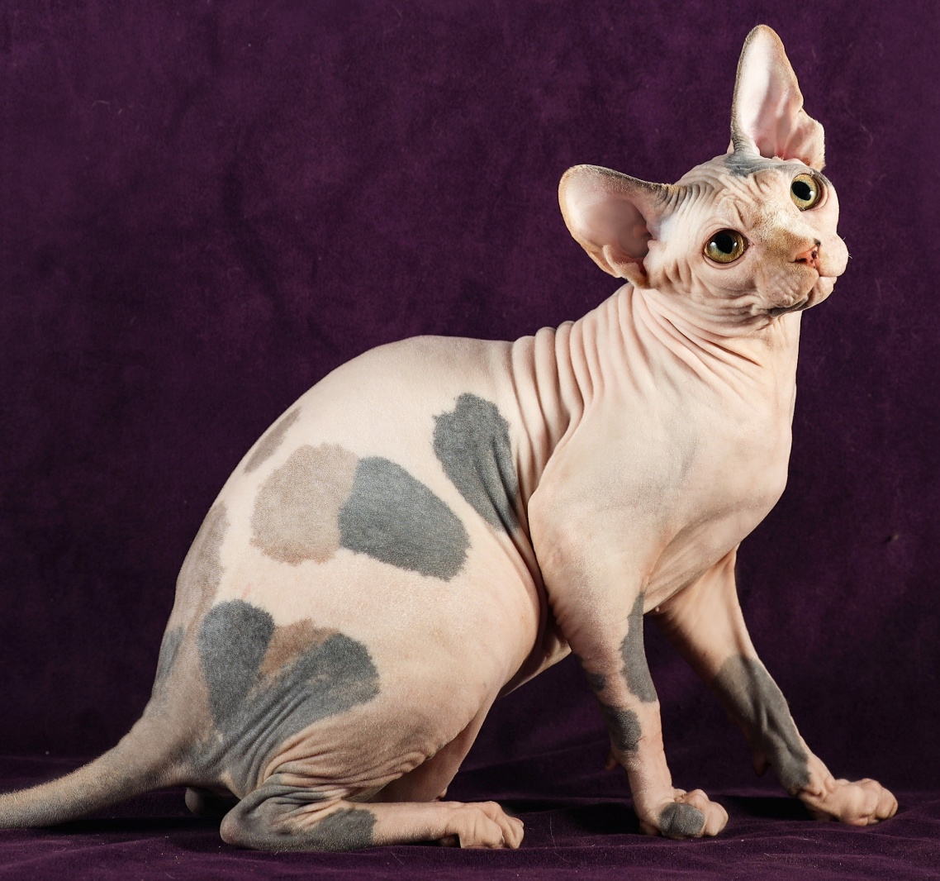
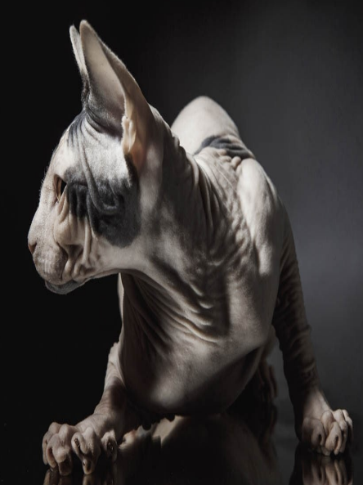
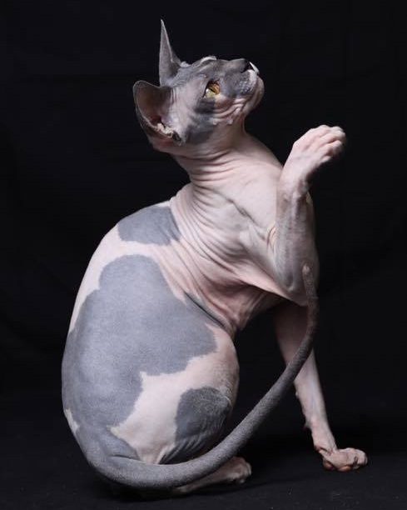
FIRM CHIN
Stripping the hair away, leaves us with a perfect view of the difference a firm chin
makes on the cat’s profile without interference from the fluff - both from the side and three quarters views.
Luckily we have a breed of cat that already comes in a hairless variety to model this for us! It is not hard to see why these four Sphynx were selected as world-class winners.
Cats, like other animals, do not have a chin bone like humans do. Instead, what we perceive as their chin, is the cat’s lower jaw and is dependent on how well the jawbone fits to the skull. Knowing this, it makes sense that this is an important feature. A firm chin is the ideal for all breeds and is the result of a jaw that is neither undershot or overshot.

Slide 4
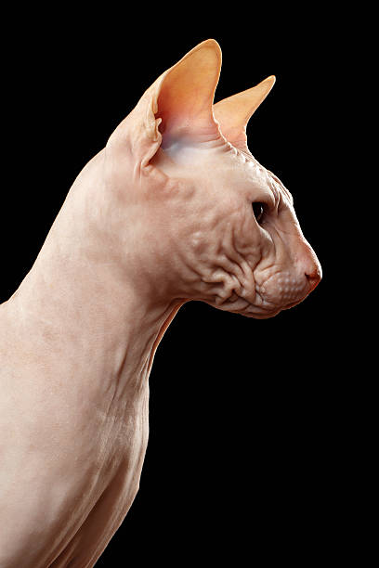
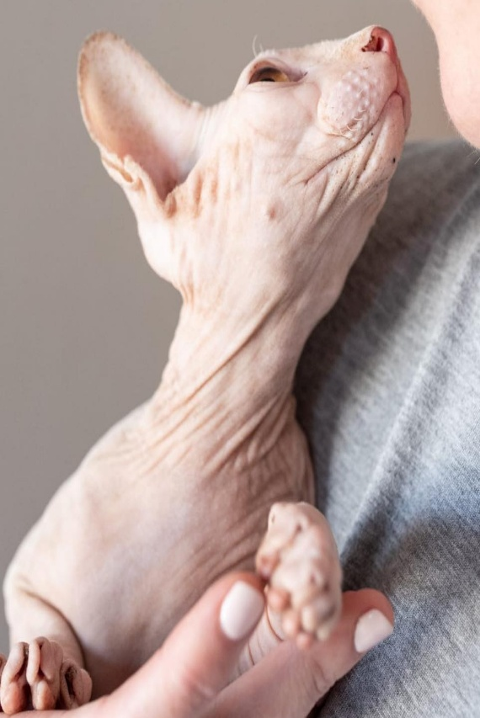
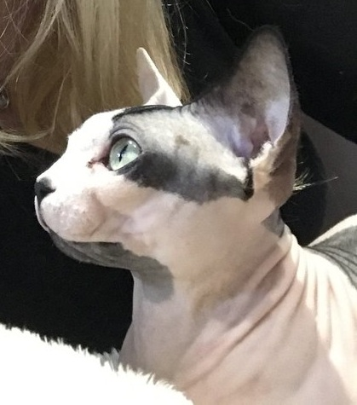
WEAK CHINS
In the same breed, the chin is now seen falling away to various degrees in the following images, which makes the appearance change drastically even while most of the other features stay unchanged.
Although the hairlessness makes for a great example to show this trait, the same is true in every other breed and thus makes this our first desired feature.

Slide 5

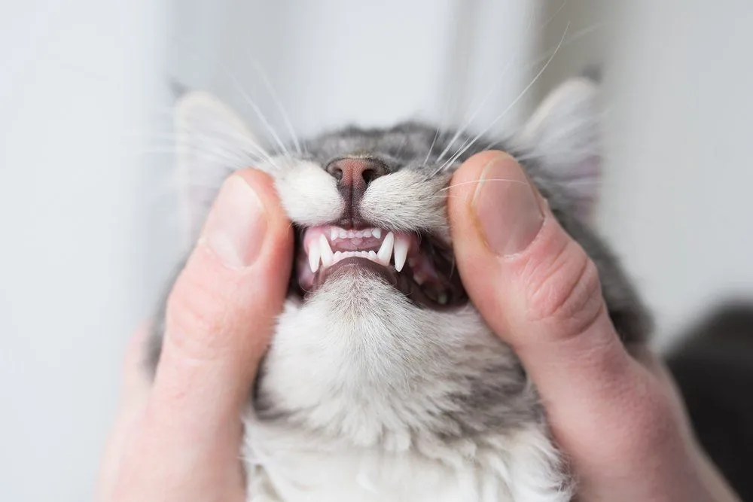
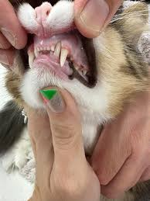
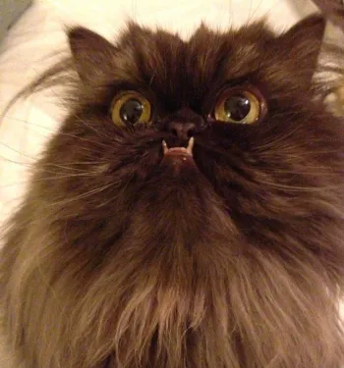
LEVEL BITE
A Level Bite means the upper and lower teeth line up well.
This is the ideal position that we would like to see.
Any deviation from this position, may result in issues with
grooming and eating and is unwanted – especially in breeding cats who will pass on these traits to their offspring.
Undershot - this is the result of the lower jaw being positioned too far forward in the skull and is not ideal.
Overshot - this is the result of the lower jaw being positioned too far backwards in the skull and is also not the ideal.

Slide 6

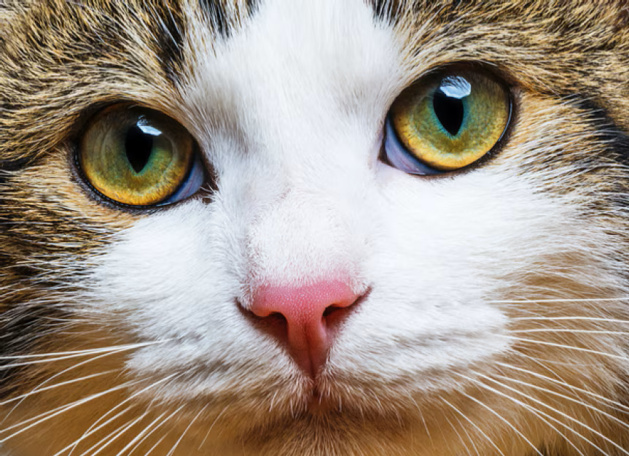
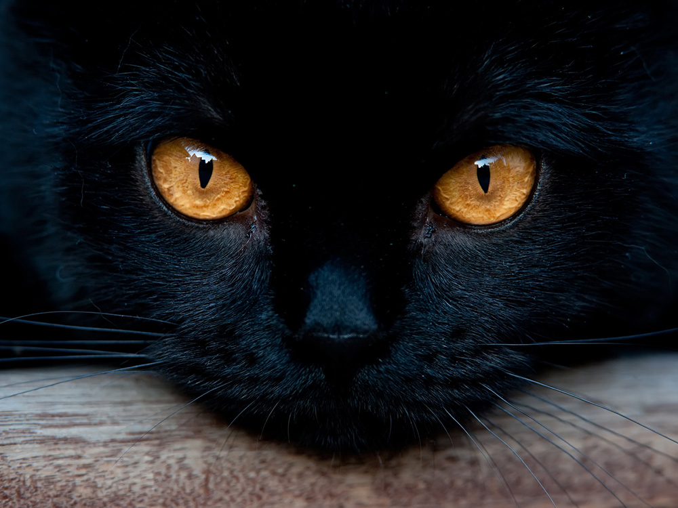
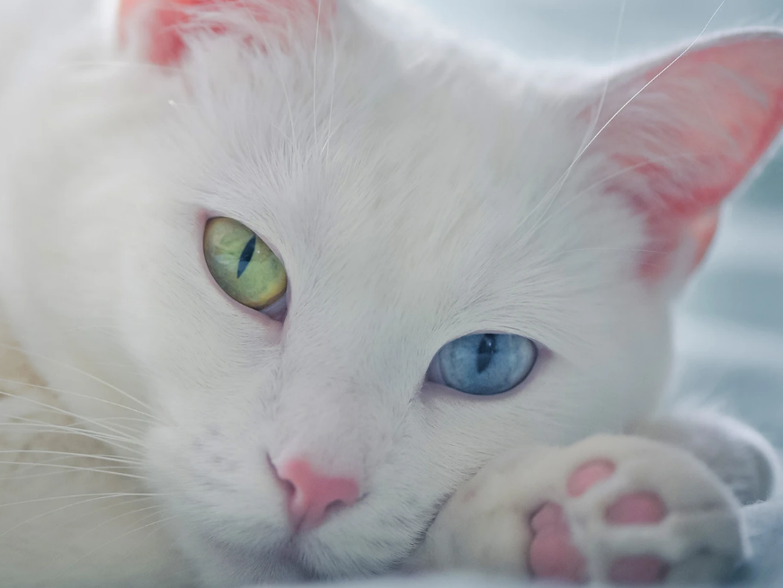
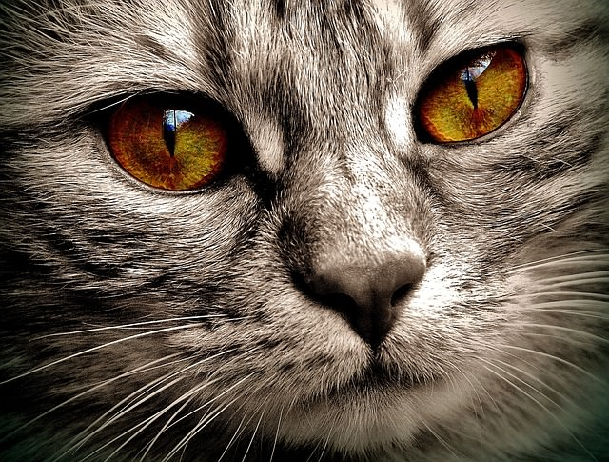
EYES CLEAR AND BRIGHT WITH EVENNESS OF COLOUR
A cat’s eyes are a clear indication of their overall health and wellbeing.
Regardless of their colour, a cat’s eyes should be clear and bright like little shimmering gemstones.
The eye colour should be even all throughout the eye.

Slide 7
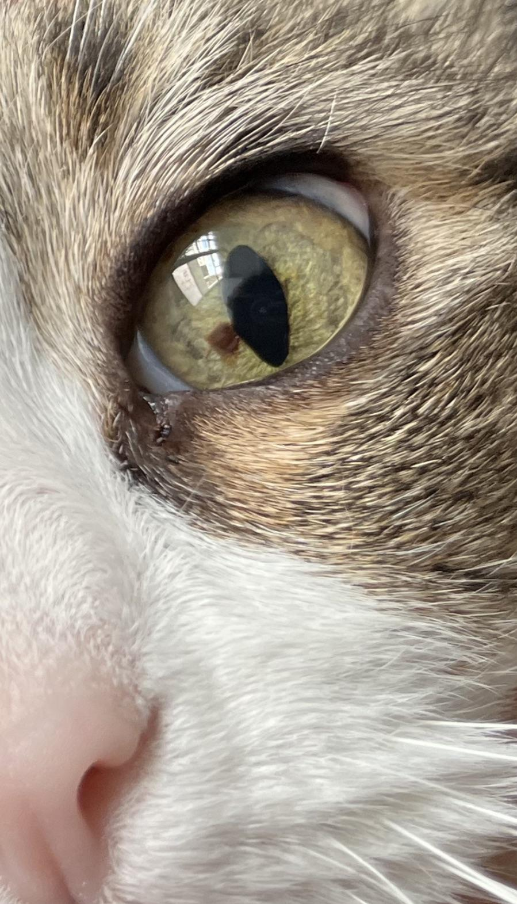
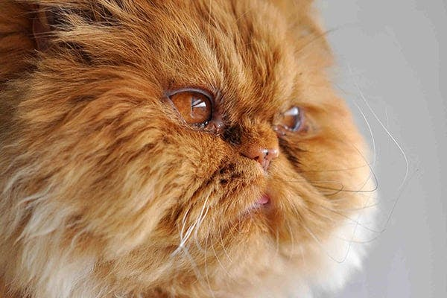
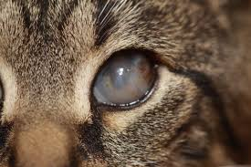
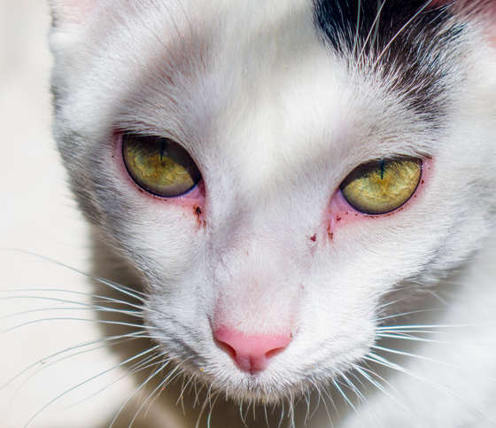
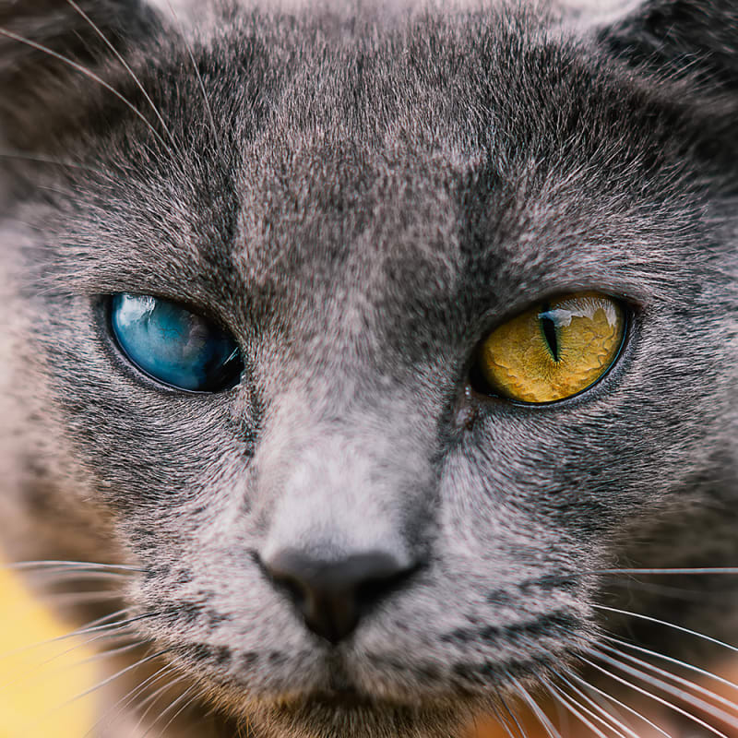
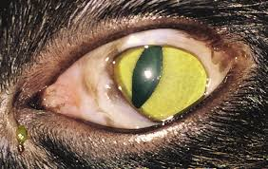
EYES ISSUES
Numerous cat eye issues exist, ranging in severity from mild to very serious and commonly include scratches, Ulcers, Glaucoma, Symblepharon and Corneal Sequestrums.
None of these are ideal to see in show cats.

Slide 8

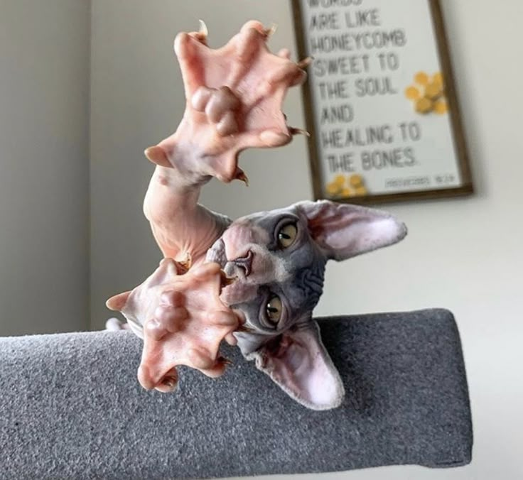
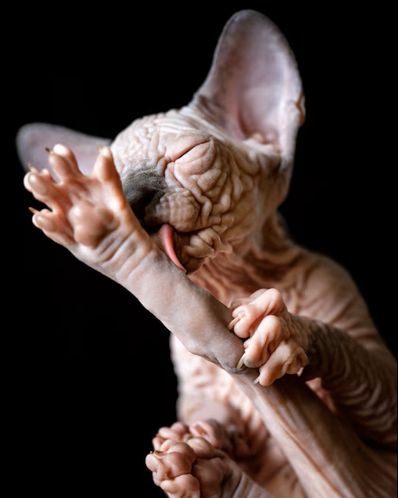
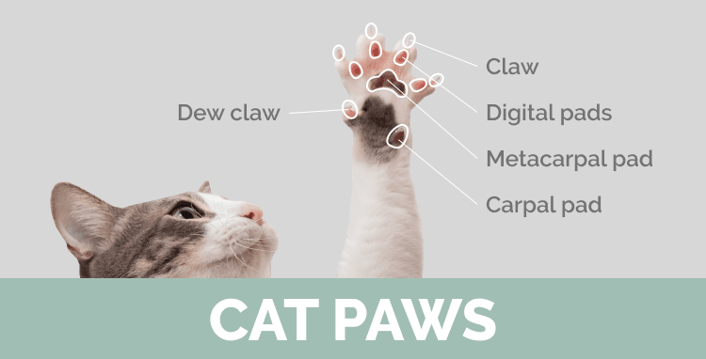

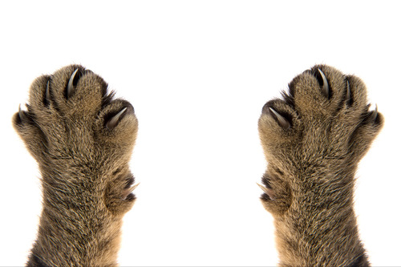
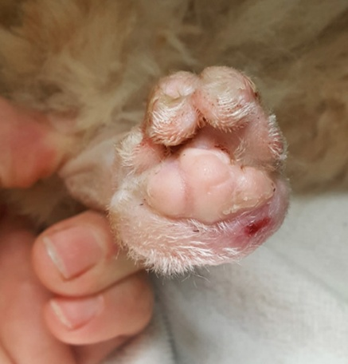

TOES COMPLETE WITH CLAWS
Once more I reach for the magnificent Sphynx to show the amazing structure of the cat paw in all its glory without all of that hair getting in the way!
Cats should have five toes on each front paw, this includes the dew claw, as well as four toes on each hind paw.
These toes should each have a claw, which hopefully is neatly trimmed on show day. Declawing is not allowed and these cats will be disqualified.
CLAWS

Slide 9

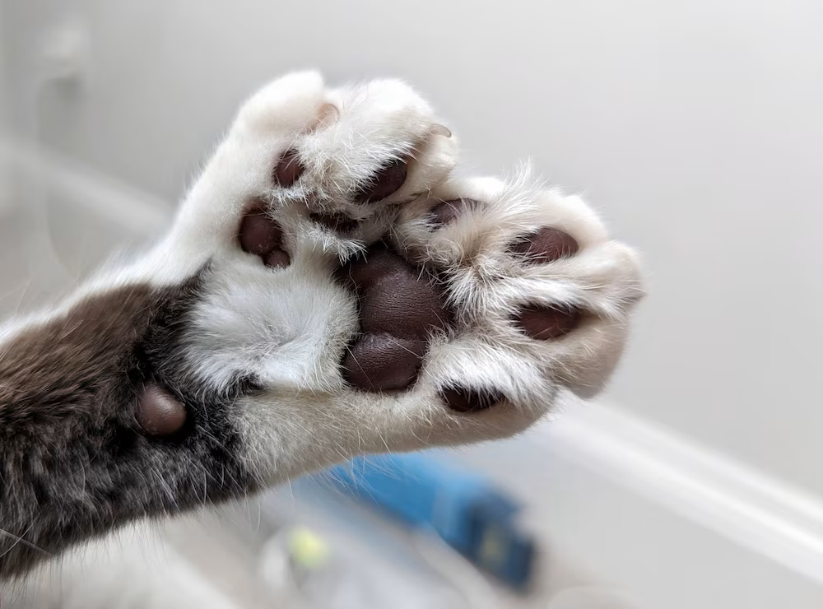
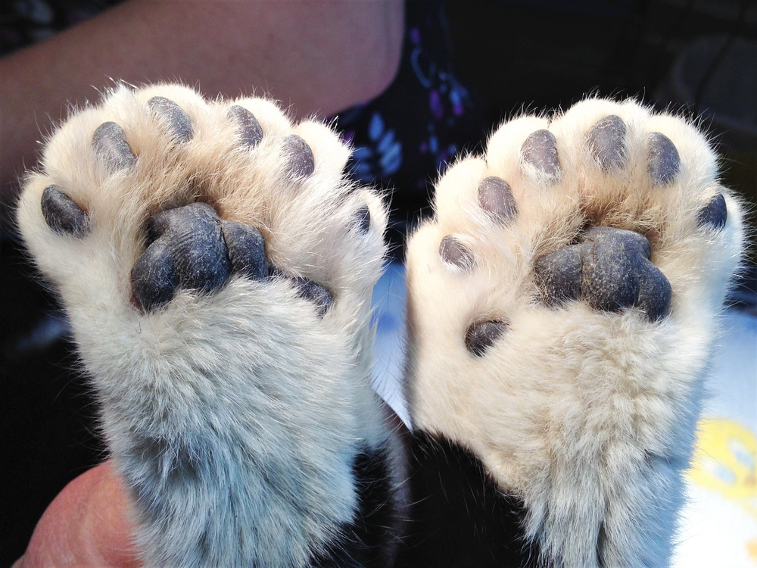
POLYDACTYLY
Cats should have five toes on each front paw and four toes on each rear paw. However, some cats are born with more than the allotted number!
This is called Polydactyly and is a congenital condition caused by a mutation during fetal development that sometimes happens in cats.
Polydactyl paws have too many toes, and is thus not desirable in show cats. Since Polydactyly is passed along through inheritance, this is especially undesirable in breeding cats.
There does seem to be an alarming rise in breeders abroad specifically choosing cats for these traits, ignoring the cat’s comfort and wellbeing in the process.
Luckily this practice is not encouraged locally.

Slide 10
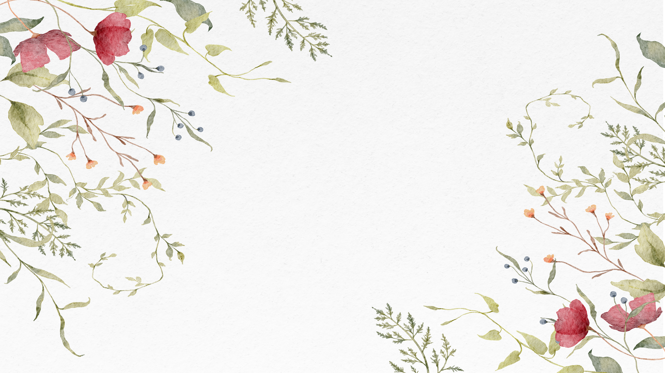
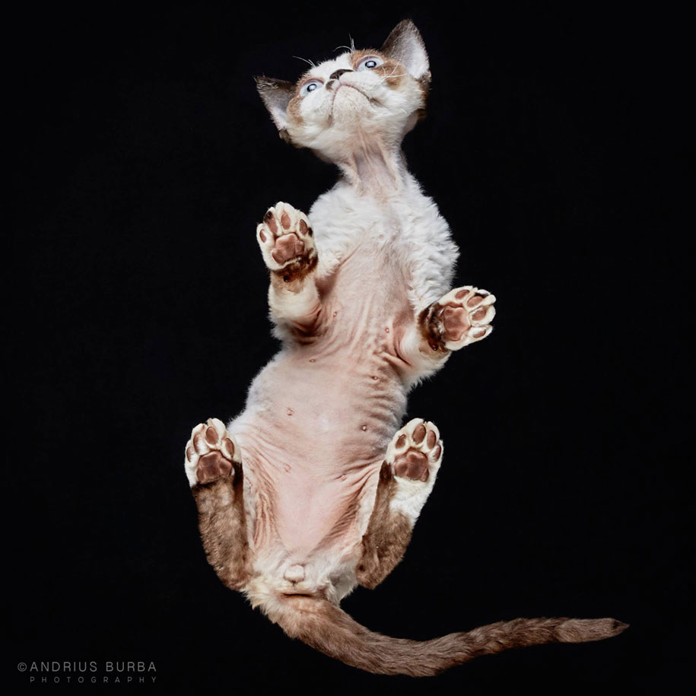
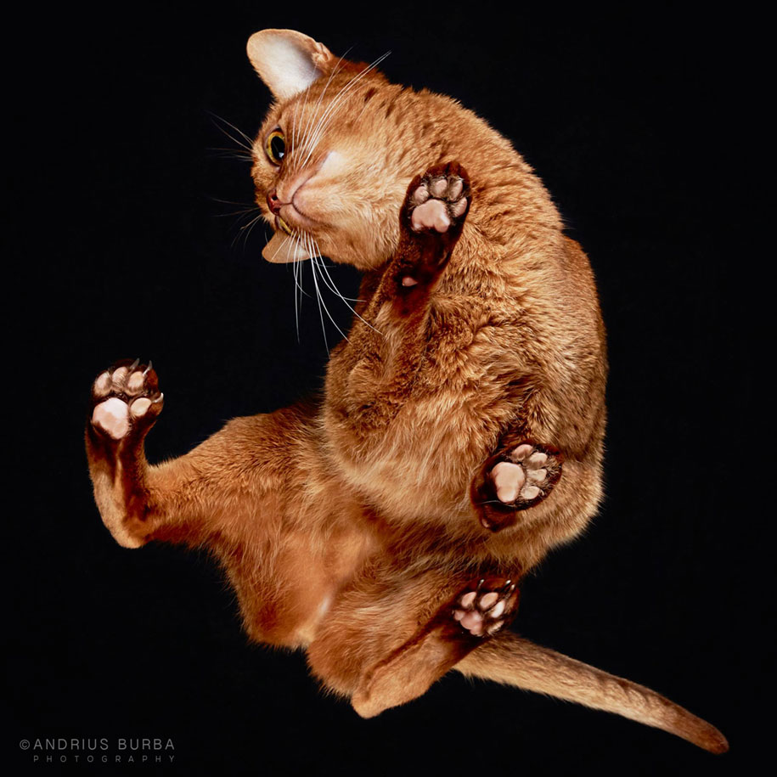
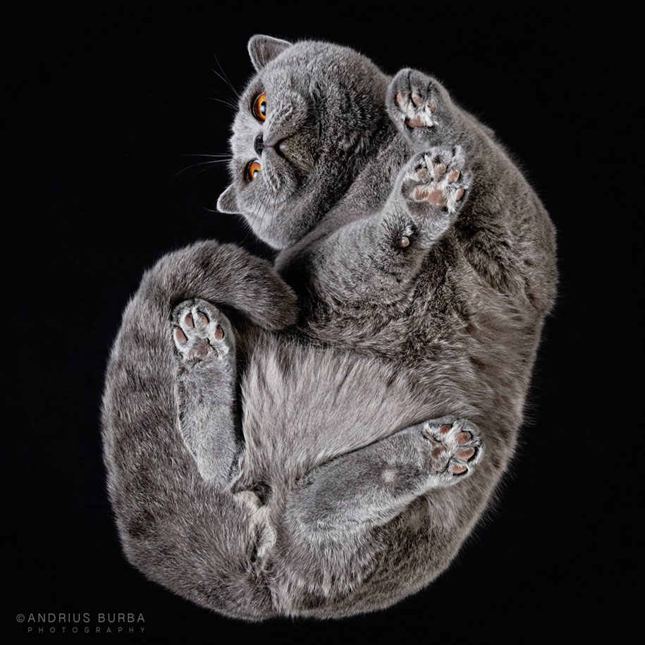
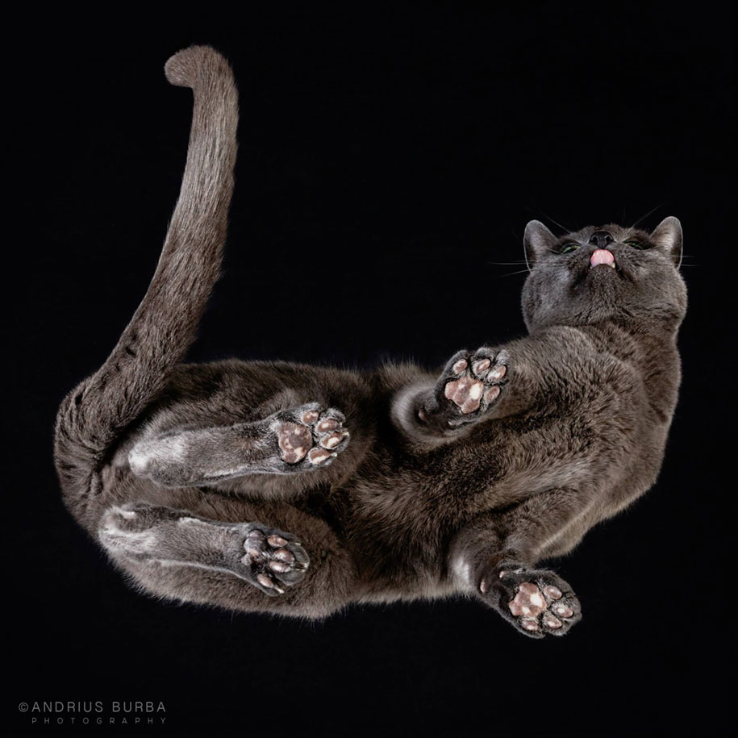
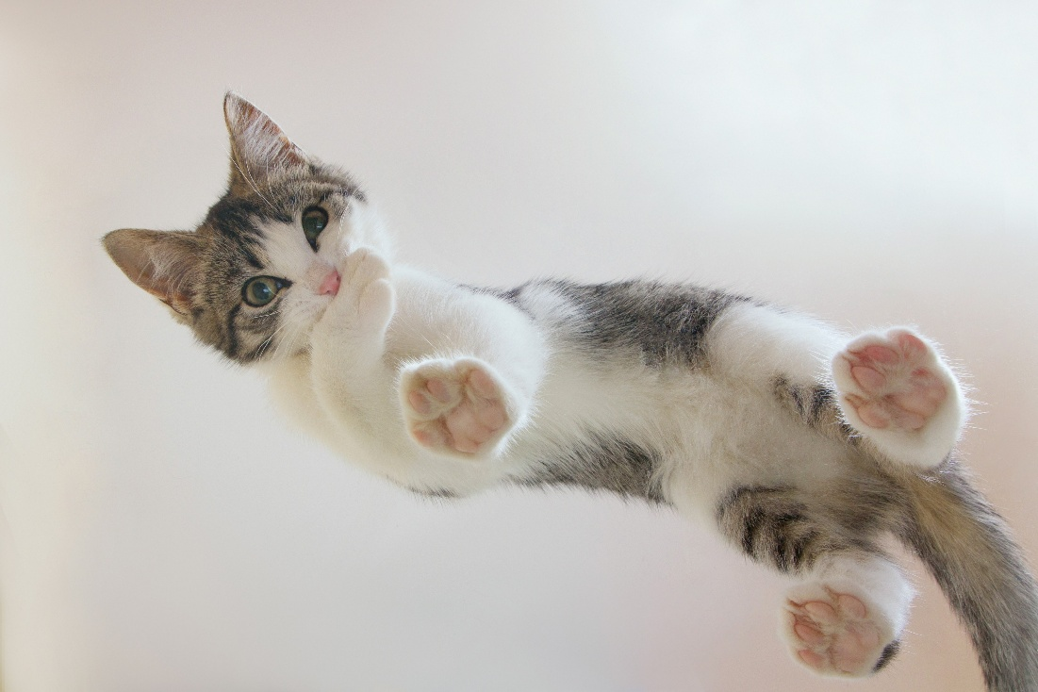
CORRECT NUMBER OF TOES

